Slide 1
Heidi LeSane
U.S. Environmental Protection Agency
Region 4

Slide 2
Federal Efforts to Combat Asthma Disparities
May 2013
Foundation: Effective asthma care must be comprehensive & address the environment & self management skills
Focus: Environment, in-home asthma care, local capacity

Slide 3
EPA’s Goal
Equip health, housing, environmental and health insurance programs to effectively support the delivery, infrastructure and/or sustainable financing of environmental asthma interventions at home and school.

Slide 4
Our Approach: Securing Sustainable Financing for In-Home Asthma Care Services
Equip 300 health, housing, environmental and health insurance programs to effectively support the delivery, infrastructure and/or sustainable financing of environmental asthma interventions at home and school.
Influence Health Plans, State Medicaid & Key Stakeholders
Equip Programs to Act

Slide 5
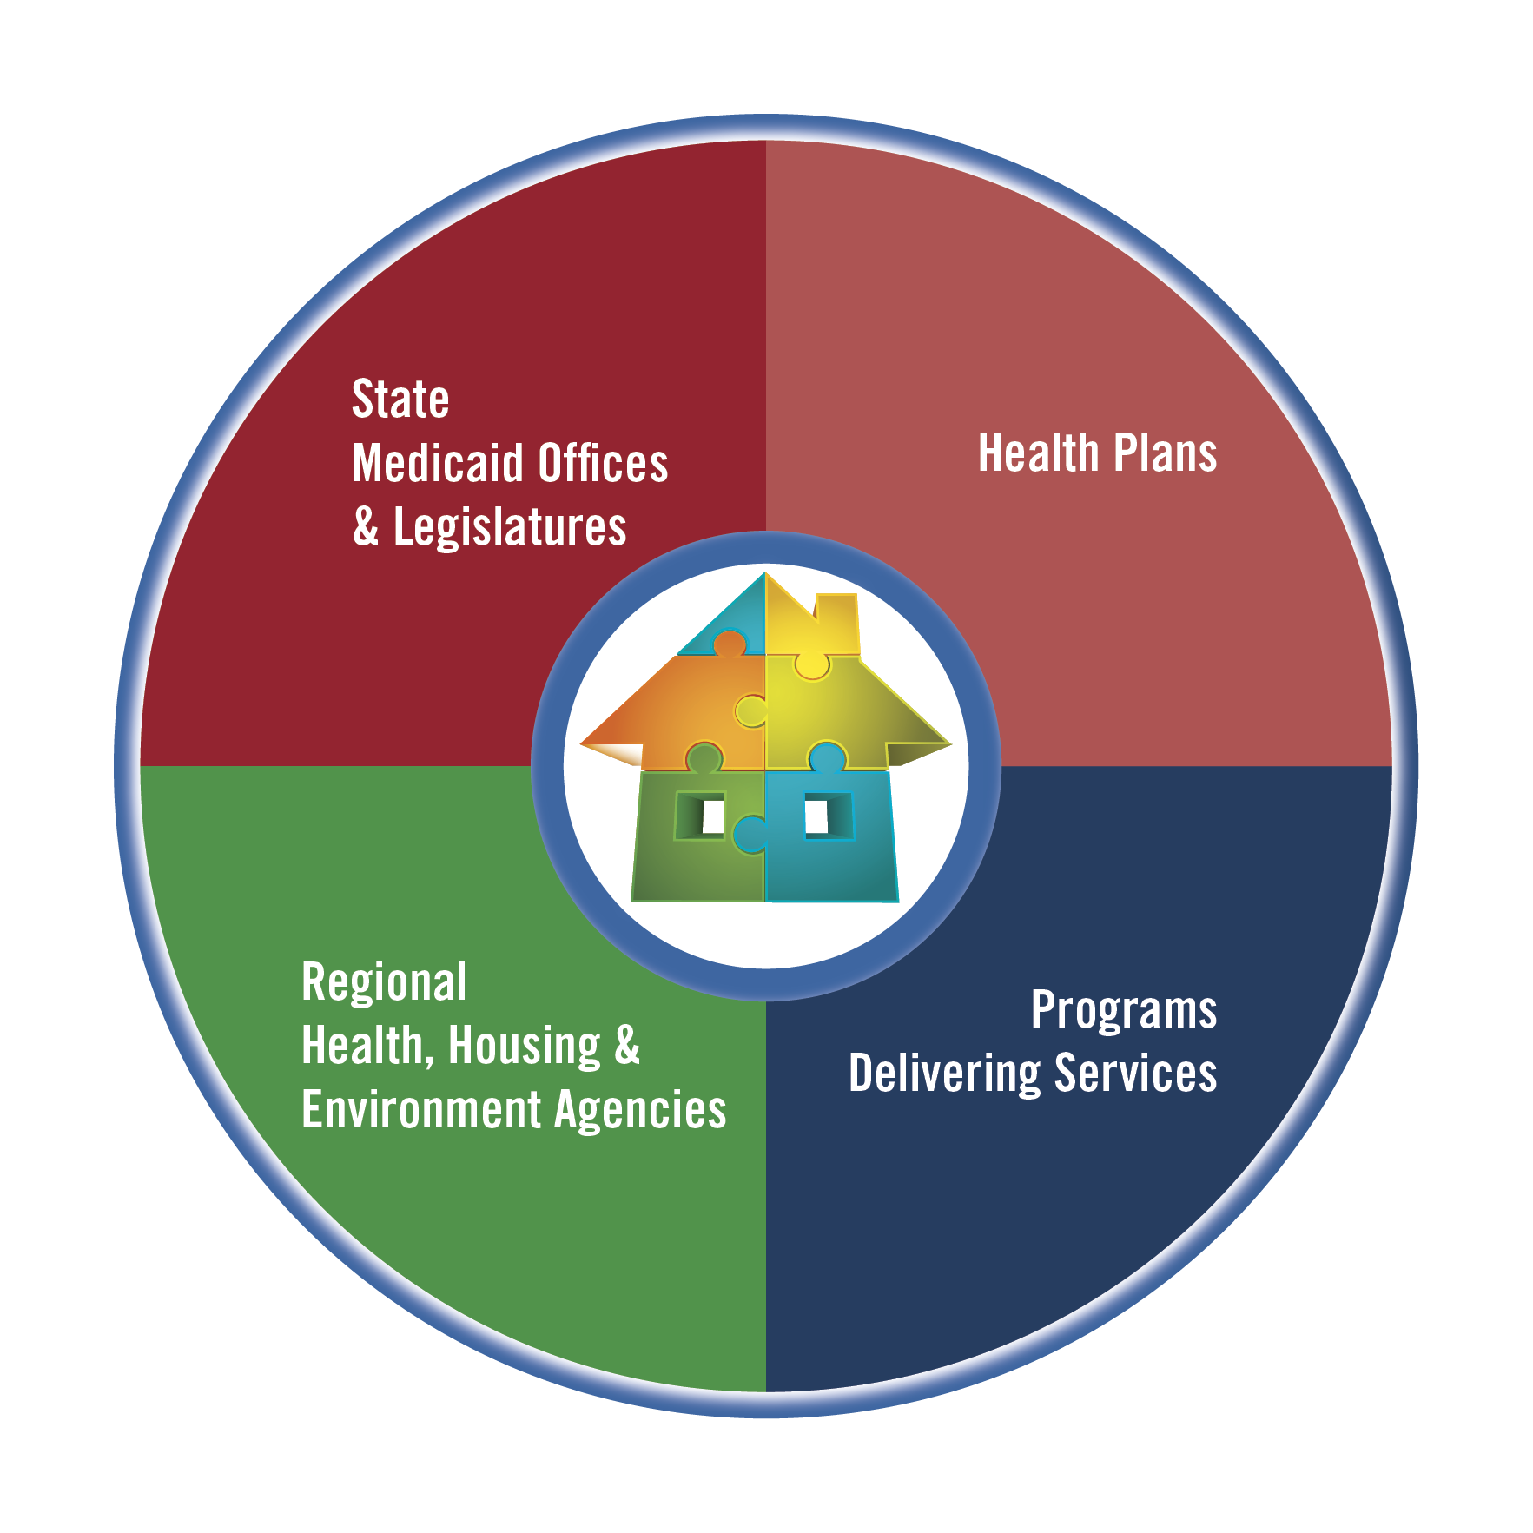
Stakeholders Who Drive Change within State Medicaid Programs
Key Interests Represented
People paying for services
State Medicaid/Legislature
Health Plans
People delivering services
People supporting and driving change
Regional health, housing and environment

Slide 6
Key Considerations for Securing Sustainable Financing
Delivery Provider
Community Health Worker
Nurse, RT, other licensed practitioner
Program Components
Education
Environmental assessment
Intervention/Remediation
Community Support System & Infrastructure
Link with clinical care
Connection to housing & environment programs
Population served
Program Outcomes & Return on Investment

Slide 7
Communities in Action

Slide 8
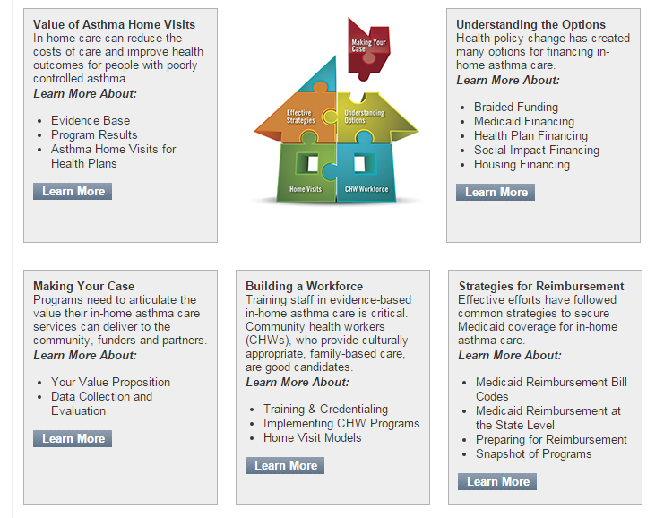
Financing In-Home Asthma Care
Resources are bucketed for ease of use and to highlight key topic areas.

Slide 9
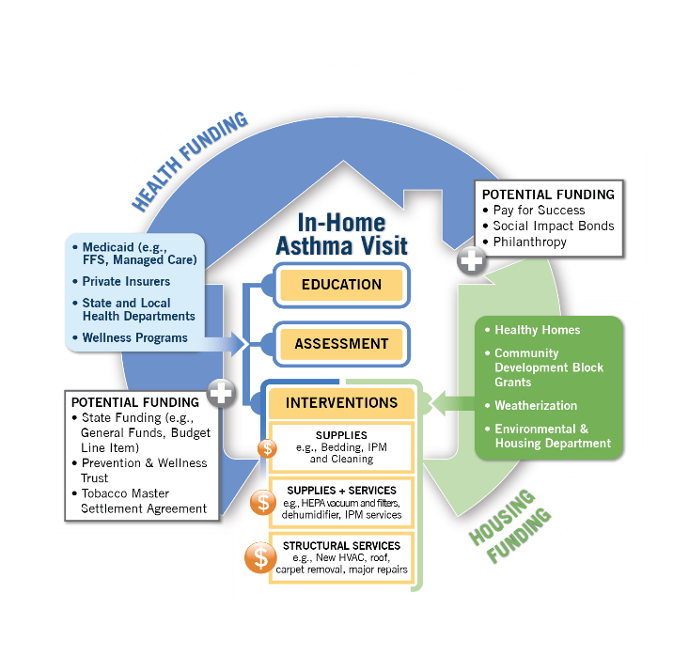
Financing In-Home Asthma Care
Understanding Sustainable Financing Options
Bringing multiple streams of funding together to cover the full spectrum of in-home asthma care is often referred to as "braided funding."
The illustration here represents ways that funding for home-based asthma care services can be combined to cover critical in-home asthma care needs.

Slide 10
HUD Healthy Homes Asthma Summits
Promote coverage of in-home asthma care services by Medicaid programs and private insurers (summits held in: Cleveland, Kansas City, Baltimore, Denver, Philadelphia and Los Angeles .
HUD lead with assistance from EPA, CDC, and HHS Asst. Sec for Health.
EPA is active collaborator and participant (highlights work from “local champions” and organizations that have made progress on the issue).
Materials from summits are posted on EPA’s Asthma Community Network website: www.asthmacommunitynetwork.org/resources/conferences/

