Slide 1
North Carolina Forum on Sustainable In-Home Asthma Management
Frances Martini, BSN, MBA
September 13, 2016
©BlueCross BlueShield of Tennessee, Inc. proprietary and confidential information. Do not disclose or reproduce without prior written consent of BlueCross BlueShield of Tennessee, Inc.
Notes:
What about he original title – Strengthening our Culture of Quality through Population Health?

Slide 2
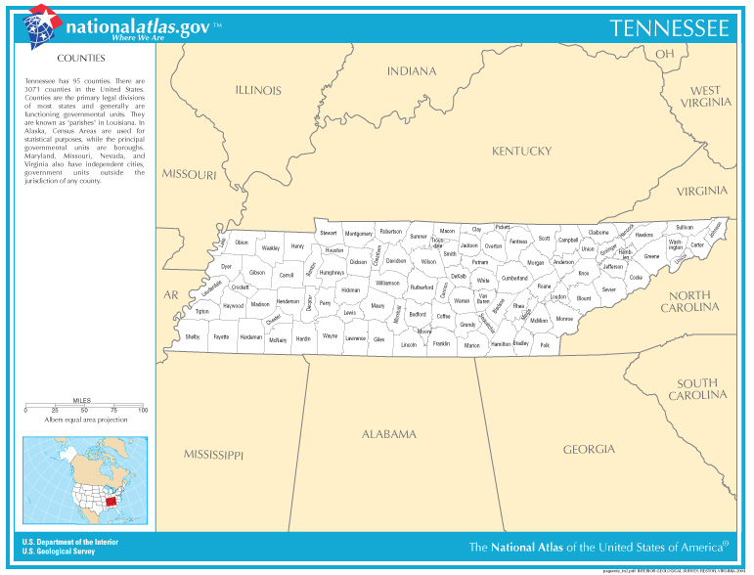
Who We Are …….

Slide 3
Background
Report on asthma prevalence, environmental risks factors and patient medical utilization
In the top 20 cities of challenging places to live with Fall allergies in 2015, Memphis ranked 4th, Knoxville 6th, Chattanooga 15th, Nashville 20th
Source: Asthma and Allergy Foundation of America (AAFA’s). Allergy Capitals 2015. http://www.aafa.org/media/Fall-Allergy-Capitals-List-2015.pdf

Slide 4
Why is a Managed Care Organization (MCO) Interested in Asthma?
Asthma continues to be a serious public health problem.
Asthma is identified in the top 10 primary disease conditions for high cost claims in the our BlueCare population.
We are on a fixed income.

Slide 5
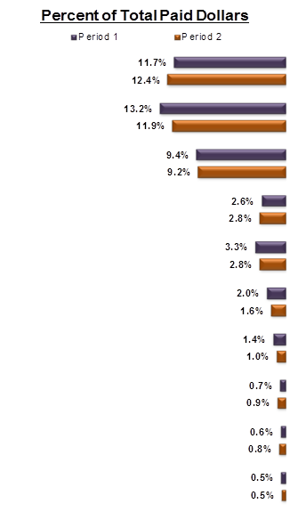
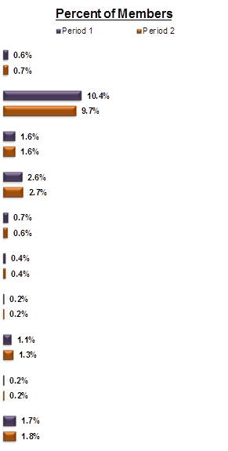
Primary Chronic Disease Incidence and Cost BlueCare All (excluding Select Kids, CHOICES, Select Community, BC Plus) Ages 4 and Under

Slide 6
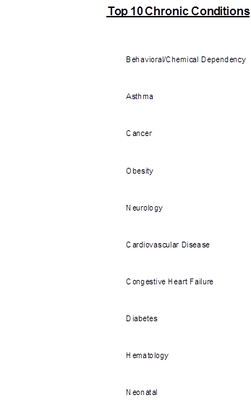
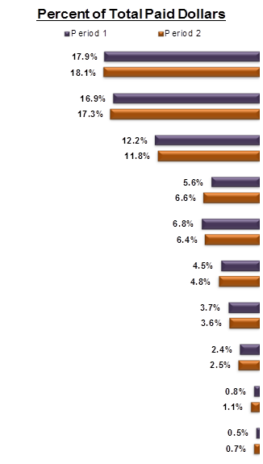
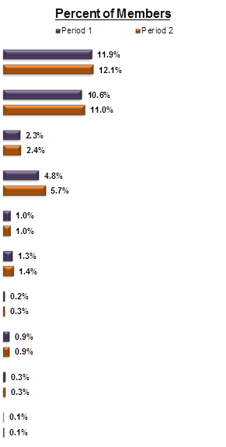
Primary Chronic Disease Incidence and Cost
BlueCare All (excluding Select Kids, CHOICES, Select Community, BC Plus) Ages 5 to 20

Slide 7
Problem
An individual’s care is often fragmented and treatment compliance is difficult to evaluate.
It may be difficult and challenging for primary care providers to ascertain what monitoring or medications are lacking for each patient/member.
Members may seek care for their asthma in multiple settings (primary practitioner office, specialist office, hospital, home health care, emergency room, community outreach events/health fairs) and therefore the primary practitioner may not have a comprehensive picture of the member.

Slide 8
Identified Barriers from 2015 Analysis
Impact of healthcare disparities
Member/parent or guardian non-compliance / failure to adhere to treatment recommendations and obtain appropriate follow-up care
Members are unreachable / failure to show for scheduled appointments/case manager is unable to contact them
Lack of provider awareness / lack comprehensive picture of member behavior / ED utilization and follow up
Inability to adequately assess home environment and remediate triggers

Slide 9
Analysis of Disparities in our Population
Disparities in health care and outcomes exist across all diseases or conditions for many reasons.
The National Healthcare Quality and Disparities Report found that people in poor households experienced the largest number of healthcare disparities.
BlueCare of Tennessee has a vested interest in identifying and addressing healthcare disparities among its membership. We do an annual assessment of key conditions is necessary to determine the scope of the disparities found in the our population.

Slide 15
What did we do with this information?
Identified counties where these populations are.
Evaluated the delivery system, resources, specialty services available.
Eliminated telephonic management where possible.
Deployed our staff living in these communities to ensure our staff matched the makeup/characteristics of the population.
Coordinated with external partnerships including providers (practitioners, facilities and ancillary service), community partners (housing, food, clothing, medication assistance, financial assistance, child care services).
Require diversity training for all staff at hire and annually.
Established a disparities advisory panel in each region to better understand the population and gain insight into best ways to reach the population.

Slide 16
Interventions (Actions for Improvement)
Improve the coordination of care
PCP follow after 3 or more asthma related ED visits in 3 months.
Outreach to member/parent/school
Engage PCP
Assess member – Face to face
Facilitate the coordination of care and exchange of information between the ED, PCP and the home health care.
Place embedded care coordinator in 2 high volume pediatric provider offices (Memphis - 2013 and Johnson City - 2015) and in 33 PCMH practices to facilitate the coordination of the members care.
Developed a pilot program to coordinate with school health services. Implemented for 2016/2017 school year.

Slide 17
We are continuing efforts to change the trend
Educational outreach – local, face to face
Support of in-school clinics/telemedicine
Community resources/coordination
Disparity advisory panels
Payment for home health visits for education
Payment for home environmental assessments
Plan for payment of home remediation (CEA)
Initiatives to incentivize both the member and the provider.
Pay for gaps
Pharmacy calls to members

Slide 18
Questions?

