Slide 1
HUD’s Perspective
Peter Ashley, DrPH, Director
Policy and Standards Division
Office of Lead Hazard Control and Healthy Homes
U.S. Department of Housing and Urban Development

Slide 2
HUD’S Perspective on Creating Healthy Homes
Peter J. Ashley, DrPH
Office of Lead Hazard Control and Healthy Homes
U.S. Department of Housing and Urban Development

Slide 3
Potential Impacts of Unhealthy Housing
Hazards
Health Effects
Other Impacts
Lead poisoning, which causes
Health problems
Hyperactivity
Reduced IQ
Behavioral Problems
Learning Disabilities
Costs to the Individual
School absenteeism (asthma is a leading cause)
Missed work days for caregiver
Diminished quality of life
Learning difficulties (lead exposure)
Increased medical expenses
Lead
Pests Dampness Mold VOCs
Tobacco smoke
Asthma
Substandard housing
Radon
Cancer
Costs to Society
Increased healthcare
costs
Reduced productivity
Lower educational attainment
Increased risk of delinquency and criminal behavior (lead poisoning)
Fall hazards Electrical/Fire hazards Poisoning hazards
Unintentional Injuries
Other Health Hazards (e.g., temp extremes)
Other Health Impacts
6

Slide 4
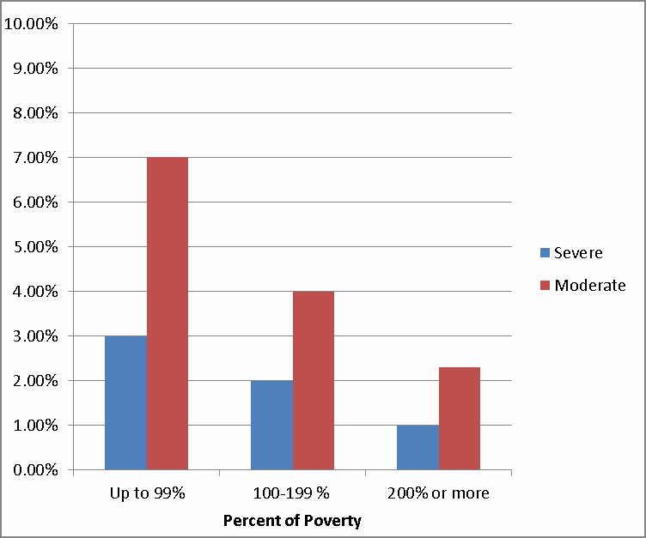
U.S. Homes With Moderate or Severe
Physical Problems by Household Poverty Status (2013)
American Housing Survey, 2013

Slide 5
Likelihood of Hazard Present by Household/Housing Characteristics
(American Housing Survey, 2011)
Household Characteristic | Hazard
 | Tobacco smoke | Fire | Falls | Mold | Cockroaches | *Lead
Minority Grp (AA or Hisp) | AA | AA+H | H | AA+H | AA+H | --
Low income | X | X | X | X | X | X
Low ed. level | X | X | X | X | X | --
Older housing | X | X |  | X | X | X
Single or MF housing | MF | S | -- | MF | MF | S
Owned/rented | R | R | R | R | R | R
*American Healthy Homes Survey, 2006

Slide 6
The National Scale of Key Healthy Housing Issues
Condition | Magnitude | Disparate Impact?
Lead exposure | 23 million homes with ≥ 1 LBP hazard 535,000 children with an EBL | Percentage of black children with an EBL is 2.3x > than white children.
Asthma | - 22.6 million in US with current asthma | Higher prevalence if below poverty level (10.9%) vs. above (< 7%) and for black-NH (16%) children vs. white (7.9%).
Unintentional residential injuries | ~ 12 million injuries requiring medical attention and ~ 18,000 deaths/yr. | Higher death rates for minority children those in poverty.
Radon exposure | 6.8 million homes with elevated radon levels 21,000 lung cancer deaths/yr. | Low income home owners may lack funds for mitigation.
9

Slide 7
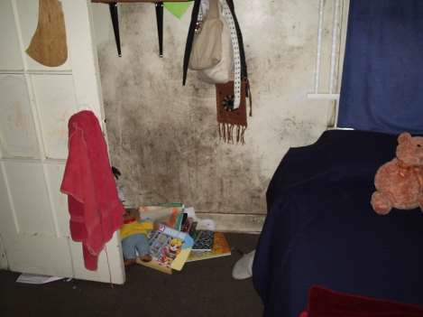
Healthy Homes Characteristics
Dry
Clean
Pest Free
Safe
Contaminant Free
Well Ventilated
Well Maintained
Thermally Controlled

Slide 8
GHHI Baltimore Family Outcomes
Smith Family - 5004 Alhambra Avenue
Pre-Intervention Situation:
Family of four with a son who has severe asthma
History of repeated asthma episodes resulting in hospitalizations on average of three times per year (Average stay: 1 week)
Deteriorated, lead hazardous windows; high dust mite levels; mouse infestation;
lack of venting; high VOC usage; poorly weatherized
Costs: $12,256 – GHHI Savings $2,159
Partners: HUD OLHCHH (HHD), CDBG, CSBG, Maryland Energy Admin., Foundations
Results: Allergens and lead hazards remediated; Home weatherized
Outcomes:
Son was not hospitalized due to asthma triggers in the home in the 12 months
post-intervention
Avoided medical costs of $48,300 in first year alone
Annual energy cost savings of $721
©2014 Green & Healthy Homes Initiative. All rights reserved.
www.ghhi.org
[ 11 ]

Slide 9
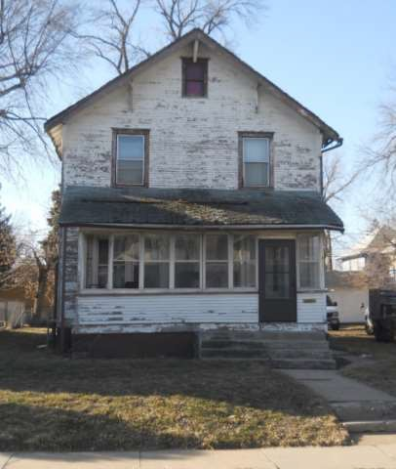
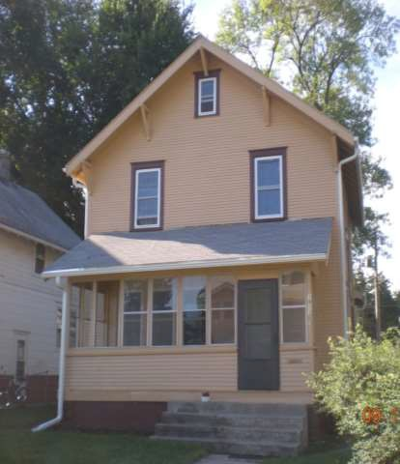
Before and After a Lead Hazard Control
Intervention
12

Slide 10
HUD Healthy Homes Perspective: Key Points
13
Target highest risk housing/populations
Conduct assessments to identify all priority hazards/conditions
Interventions should target as many priority hazards as
possible
Leverage resources through partnering and referrals (e.g., weatherization and lead hazard control, low income rehab programs, housing code enforcement)
Mainstream/institutionalize healthy homes requirements whenever possible (e.g., smoke-free multifamily housing, adoption of integrated pest management, lead-safe rental housing, radon resistant new construction)

Slide 11
14
THANK YOU!
http://portal.hud.gov/hudportal/HUD?src=/program_offices/healthy_homes
peter.j.ashley@hud.gov

