Slide 1
Morning Reflection
Tracy Washington Enger, M.S.
Indoor Environments Division
U.S. Environmental Protection Agency

Slide 2
Asthma Action Speed Dating

Slide 3
Action Areas
Getting Paid – Workgroup on Sustainable financing for in-home interventions
Getting Connected – Coalitions, People and Partnerships
Getting Smart- Information, Resources and Support
Getting Seen and Heard – events, webinars, mentorship

Slide 4
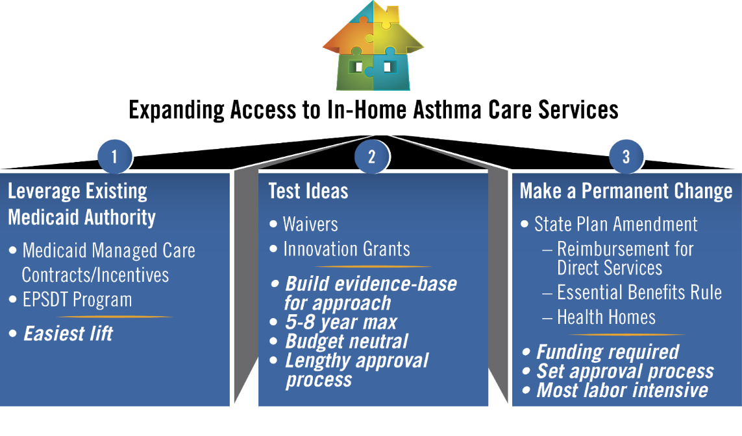
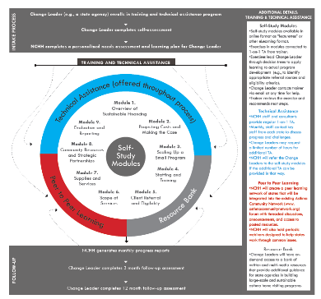
Get Paid

Slide 5
Get Connected
Join Georgia Asthma Control Program’s Environmental Workgroup

Slide 6
Get Smart

Slide 7
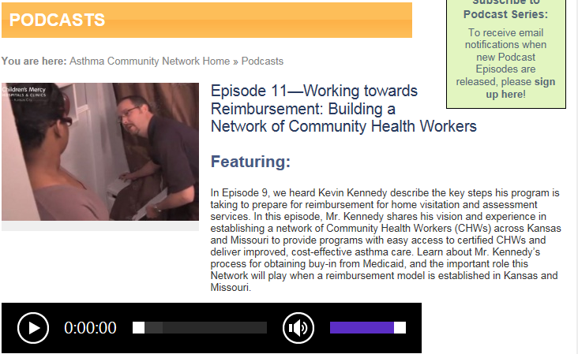
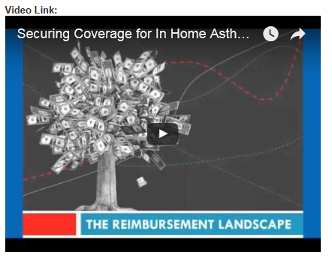
Get Seen and Heard
Join Georgia Asthma Control Program’s Environmental Workgroup

Slide 8
Keep it Moving
Write your name, organization and email address on four post-it notes
Choose a station to visit first
Chat and get to know the folks there
Leave your contact information so you can get to know them better
At the sound of the bell, move to the next station

