Slide 1





Controlling Mold and Moisture
for Better Controlled Asthma
Ginger L. Chew, ScD
Epidemiologist, National Center for Environmental
Health
Division of Environmental Hazards and Health Effects
Centers for Disease Control and Prevention

Slide 2

Mold, Allergy, and Asthma
Ginger L. Chew, ScD
Health Scientist
Air Pollution and Respiratory Health Branch
National Center for Environmental Health
Division of Environmental Hazards and Health Effects

Slide 3
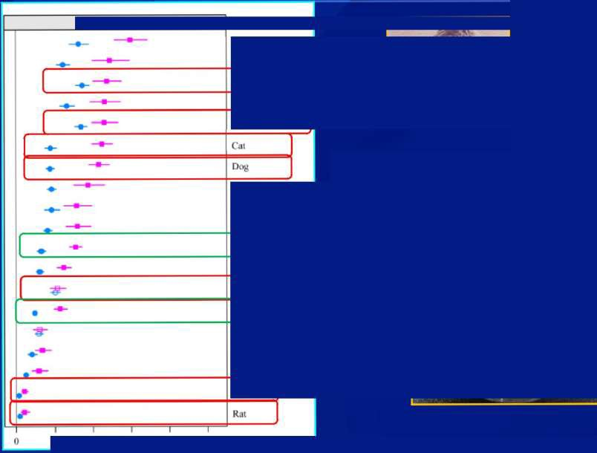
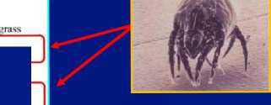
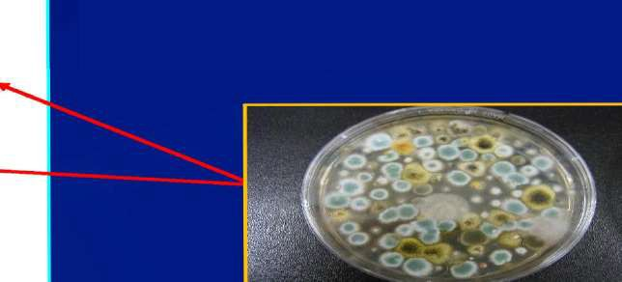
Current atle ies
Ryc grass Bermuda
D. pterooyssinus Ra ved
D. farinae
Among general population, where are indoor allergens in the hierarchy?
Oak
Russian
thistle Birch
A. alternate Peanut Cockroach
A. fionigaius
Shrimp Cow^{l}s milk E white Mouse
10 20 30 40 50
*NHANES 2005-6 IgE data
Salo et al., J. Allergy Clin. Immunol, 2011

Slide 4

Mold or Dampness and Asthma
Type of review | Criteria for sufficient evidence | Conclusion
Institute of Medicine (IOM) report (2004) | An association between the agent and the outcome has been observed in studies in which chance, bias, and confounding can be ruled out with reasonable confidence | Wheeze (yes) Asthma symptoms in sensitized persons (yes) Asthma development (no)
World Health Organization (2009) | Same as above, but added this text: “For example, if several small studies that are free from bias and confounding show an association that is consistent in magnitude and direction, there may be sufficient evidence of an association.” | Wheeze (yes) Asthma symptoms in
 |  | sensitized persons (yes) Asthma development (yes)
Systematic Review (Mendell et al 2011) | Same as above, but also included evidence from quantitative meta-analyses. | Asthma development (yes)
Meta-analysis of birth cohort studies (Tischer et al 2011) | Significant adjusted odds ratios (OR_{a}) | Asthma development (yes)
Meta-analysis (Quansah et al 2012) | Significant summary effect estimates | Asthma development (yes)

Slide 5
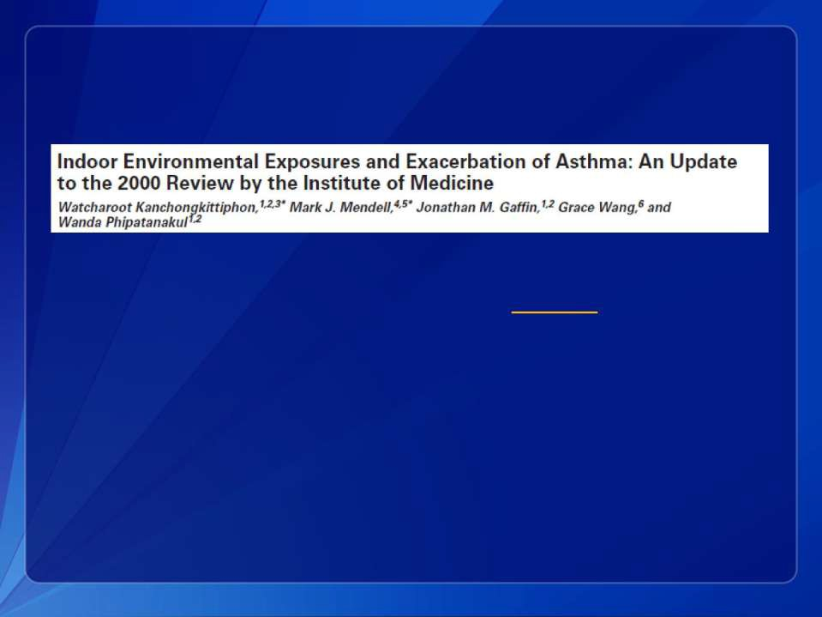
Mold or Dampness and Asthma (2015 Review)
“There is sufficient evidence of a causal association
between dampness or dampness related agents
and exacerbation of asthma in children.”
Env. Health Perspectives 123(1):6-20, 2015

Slide 6

Quantitative measurements
of mold
·
Proteins (i.e., Asp f 1 )
·
C a r b o h y d r a t e s (i . e . , E P S , g l u c a n )
·
E r g o s t e r o l ( m e a s u r e d by G C / M S )
·
M y c o t o x i n s
·
M i c r o b i a l v o l a t i l e o r g a n i c c o m p o u n d s
( m V O C s )

Slide 7
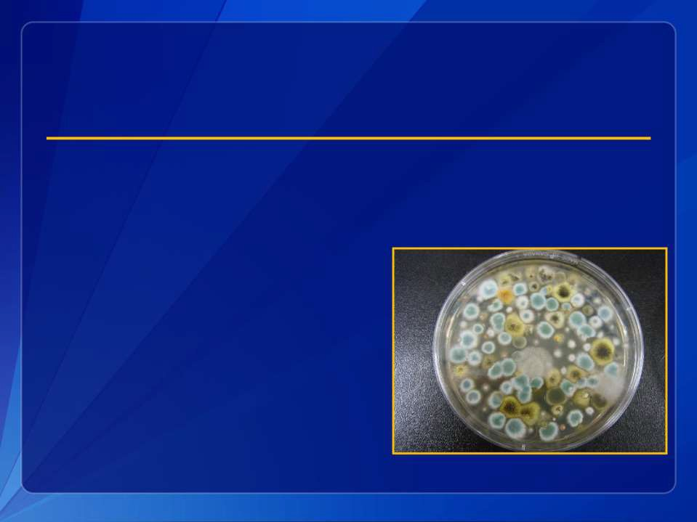
Why are Mold Allergens so Difficult to Study?
Which ones to choose?
Batch-to-batch differences in extracts

Slide 8

Alternaria Species
·
Alternaria brassiciae
Alternaria alternata
– 57 different strains listed in the American Type Culture
Collection (ATCC)
·
A. brassicola
·
A. calendulae
·
A. carthami
·
A. cassiae
·
A. chlamydospora
·
A. chyrsanthemi
·
A. cichorii
·
A. cinerariae
·
A. circinans
·
A. citri
·
A. consortiale

Slide 9
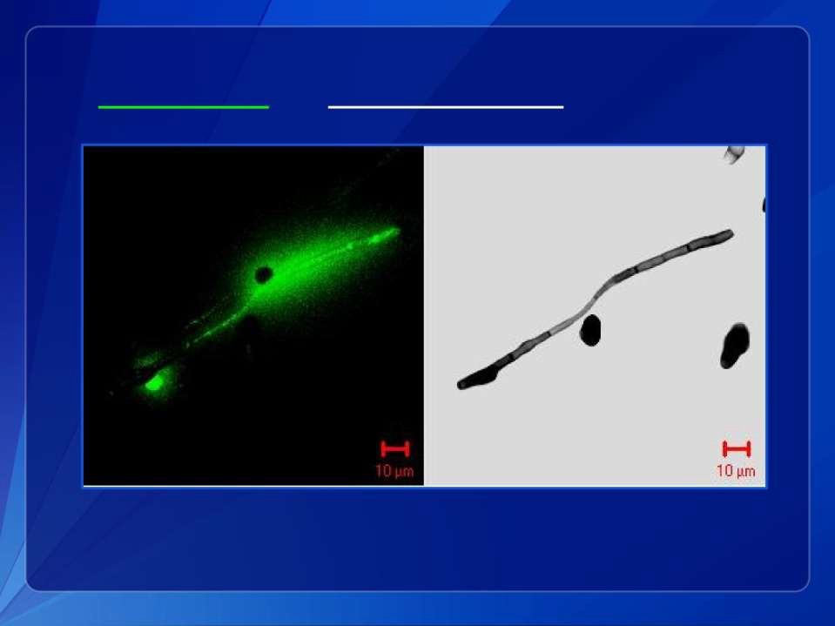
Allergens in
germinating vs. non-germinating mold spores
Green, Tovey, Beezold, Perzanowski, Acosta, Divjan, and Chew. Surveillance of fungal allergic sensitization using fluorescent halogen immunoassay. J. Mycol. Med. 19(4): 253-261, 2009

Slide 10
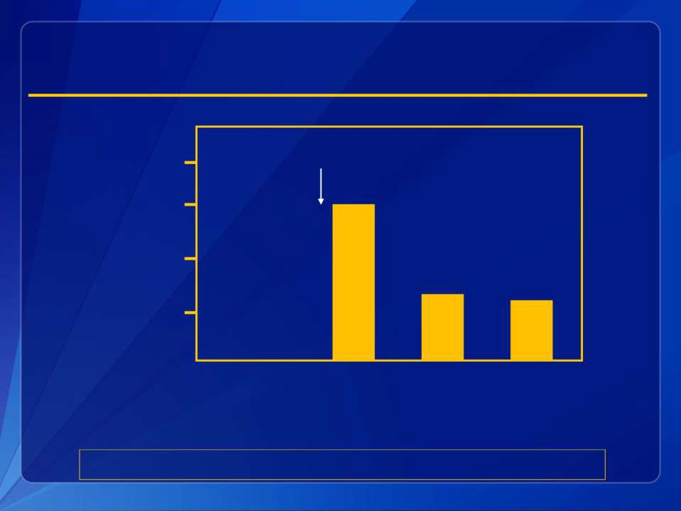
Human Activity affects airborne mold levels
Moldy bread into garbage can
Concentration of culturable spores (CFU/ cubic meter)
40,000
30,000
20,000
10,000
0 22 48 96 126
Time (minutes)
Adapted from: Lehtonen and Reponen, Int. Biodet & Biodeg. 1993

Slide 11

Cheaper and sometimes more
accurate methods
Questionnaire
Inspection

Slide 12
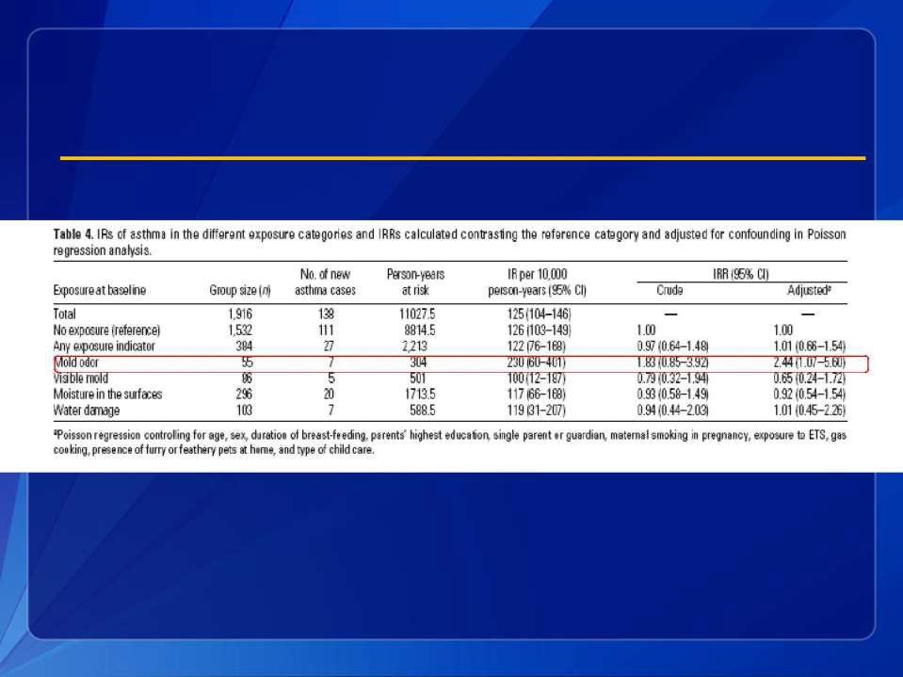
Mold exposure and childhood asthma incidence
in a Finnish prospective cohort
Jaakkola et al. Env. Health Perspect., 2005

Slide 13

Part A: Occurs in the clinic office
Tool to Determine if a Home Assessment is Warranted for Mold and Dampness (Part A)
1 | During the past 12 months, have there been water problems or dampness in your home from broken pipes, leaks, heavy rain, or floods? | Ii Yes | Ii No | Ii Don’t know
2 | In the last 12 months, how often have you noticed any moldy/musty smells inside your home? | Ii Daily Ii Weekly Ii Monthly Ii A few times a year Ii Never
3 | In the last 12 months, was there fungal growth covering an area greater than or equal to the size of an 8" x 11" piece of paper in your home? | Ii Yes | Ii No | Ii Don’t know
4 | In the past 12 months, have you noticed condensation on windows in your home? | Ii Yes | Ii No | Ii Don’t know
5 | Have any of your furnishings, clothes, possessions been in a building that had water damage? | Ii Yes | Ii No | Ii Don’t know

Slide 14
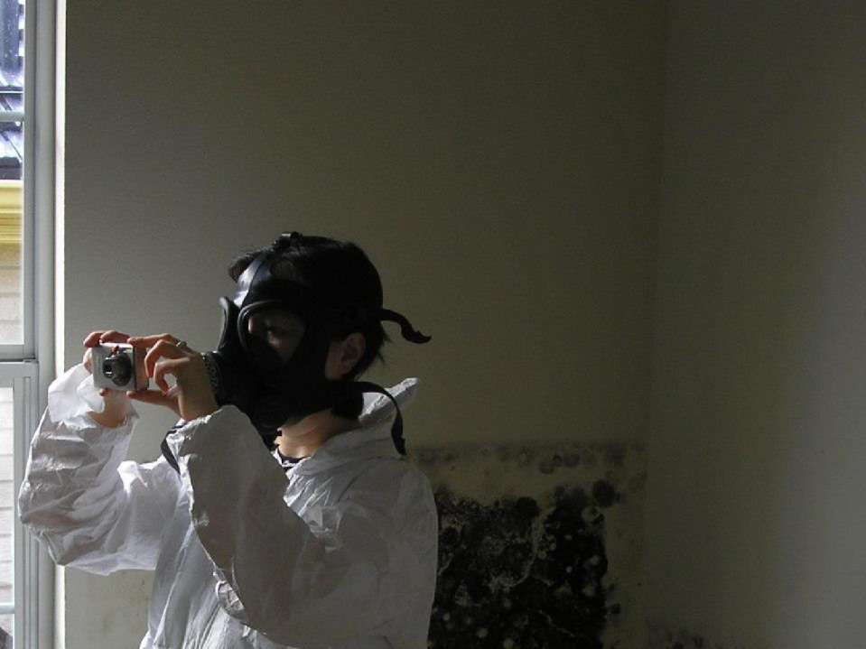

Slide 15
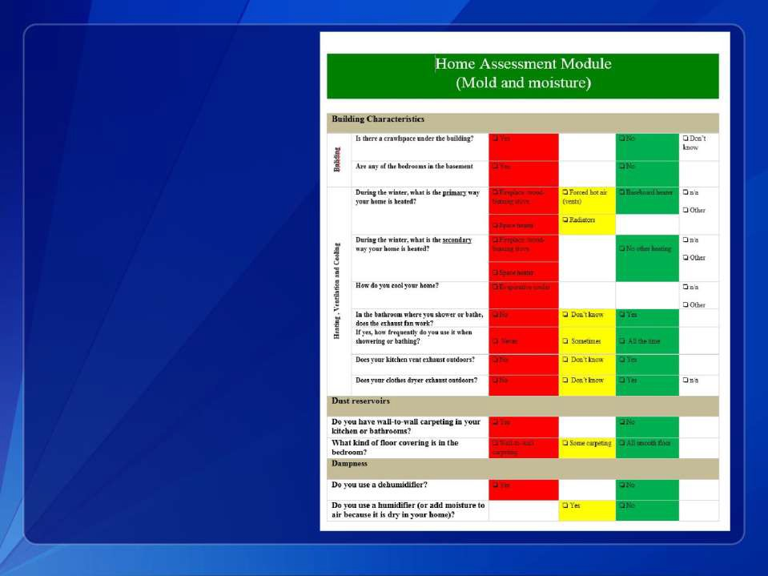
Part B: Occurs in the waiting room

Slide 16
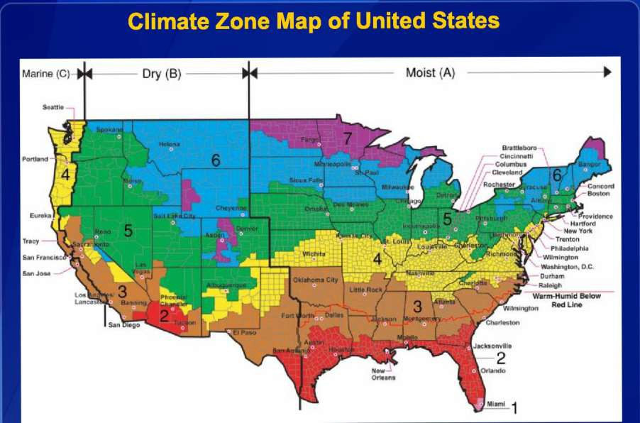
Climate Zone Map of United States
Marine (C) Dry (B)
Moist (A)
Snattha
Br:IMO fibs 0
Cincinnati
Columbus
— Cleveland
Rochester
:r;1
Eureka
Pfrovnictice
Redo
Hart^{r}orci New York
Tracy
—Trenton
Philadelphia —
Wilmington
San Franciee
`—Washington,^{\--}Washington,D.C.
San Jose
—Durham
- Raleigh
Loa Lancas
Werm•Humid Below
Wilmington Charleston
Jacksonville
2
b_{Or}le_{le}w_{an}—_{s} o Orlando
Red Line
Miami 1
* f r o m A S H R A E
9 0 . 1 ⁻ 2 0 1 0 a n d B r i g g s R S , Z T T a y l o r , a n d R G L u c a s . 2 0 0 3 . “ C l i m a t e C l a s s i f i c a t i o n f o r B u i l d i n g E n e r g y
Codes and Standards.

Slide 17

Green vs. Control homes in Cincinnati
(example of real-time data)
90
80
70
60
50
40
30
20
10
0
1 2 3 4 5 6 7 8 9 1 0 1 1 1 2 1 3 1 4 1 5 1 6 1 7 1 8
Mean Temperature of Green homes (Fahrenheit)
Mean Temperature of Green homes (Celsius)
Mean Temperature of Control homes
(Fahrenheit)
Mean Temperature of Control homes (Celsius)
Temperature
Home

Slide 18
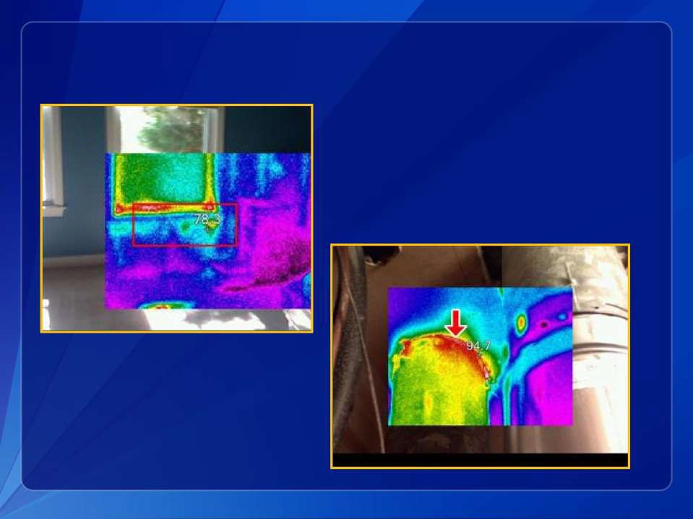
Temperature Variation

Slide 19
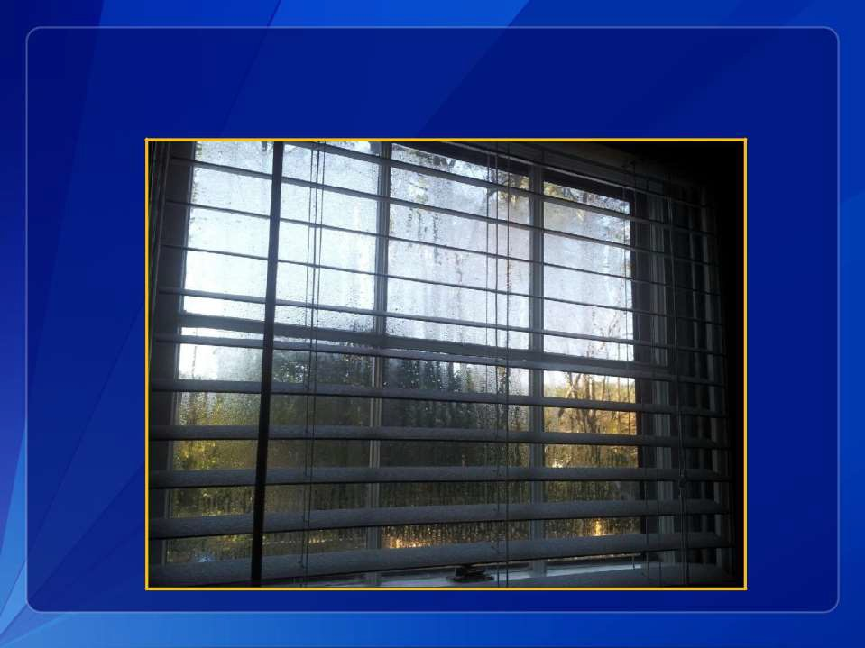
Leads to humidity variation

Slide 20
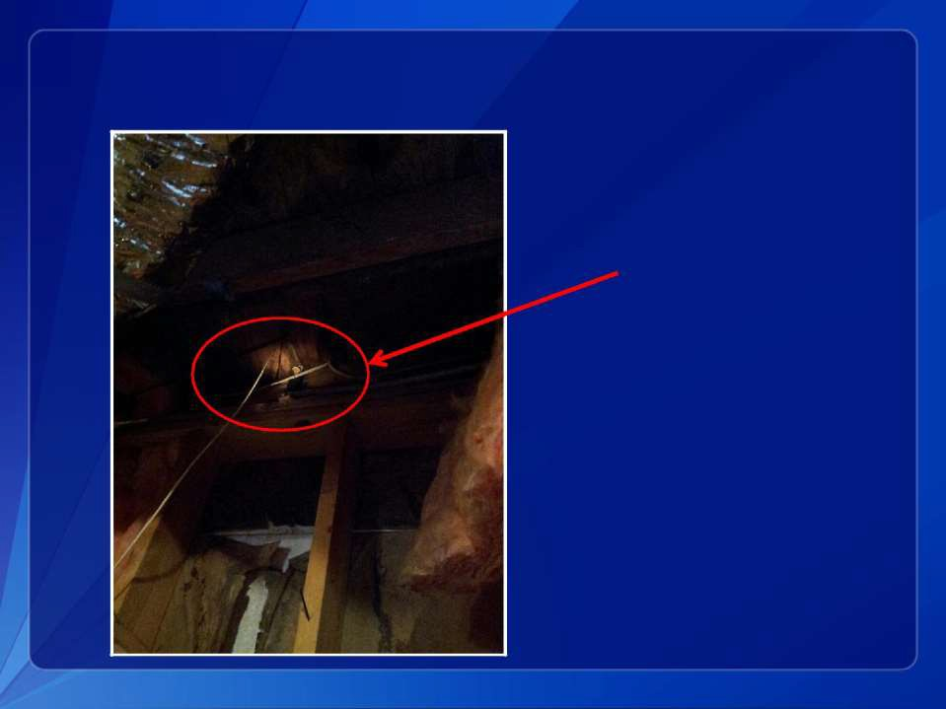
Leads to mold growth
Mushroom

Slide 21

Acknowledgments
The Environmental
Allergens Workgroup
Jay Portnoy (Chair) Charles Barnes Sachin Baxi
Ginger Chew Carl Grimes Elliott Horner Kevin Kennedy
Désirée Larenas-Linnemann
Estelle Levetin
David Miller Wanda Phipatanakul
James Scott Brock Williams

Slide 22

Thank you
For more information please contact Centers for Disease Control and Prevention
1600 Clifton Road NE, Atlanta, GA 30333
Telephone: 1-800-CDC-INFO (232-4636)/TTY: 1-888-232-6348
E-mail: cdcinfo@cdc.gov Web: http://www.cdc.gov
The findings and conclusions in this report are those of the authors and do not necessarily
represent the official position of the Centers for Disease Control and Prevention.
National Center for Environmental Health Air Pollution and Respiratory Health Branch

Slide 23
Controlling Mold and Moisture
for Better Controlled Asthma
Richard Johnson, President
Co-Chair, Fulton Asthma Improvement & Reduction Coalition (FAIR), Georgia Healthy Homes Coalition Air Allergen & Mold Testing, Inc

Slide 24

Mold & the Indoor Environment
Richard Johnson
Fulton Asthma Improvement & Reduction
Coalition co-chair

Slide 25
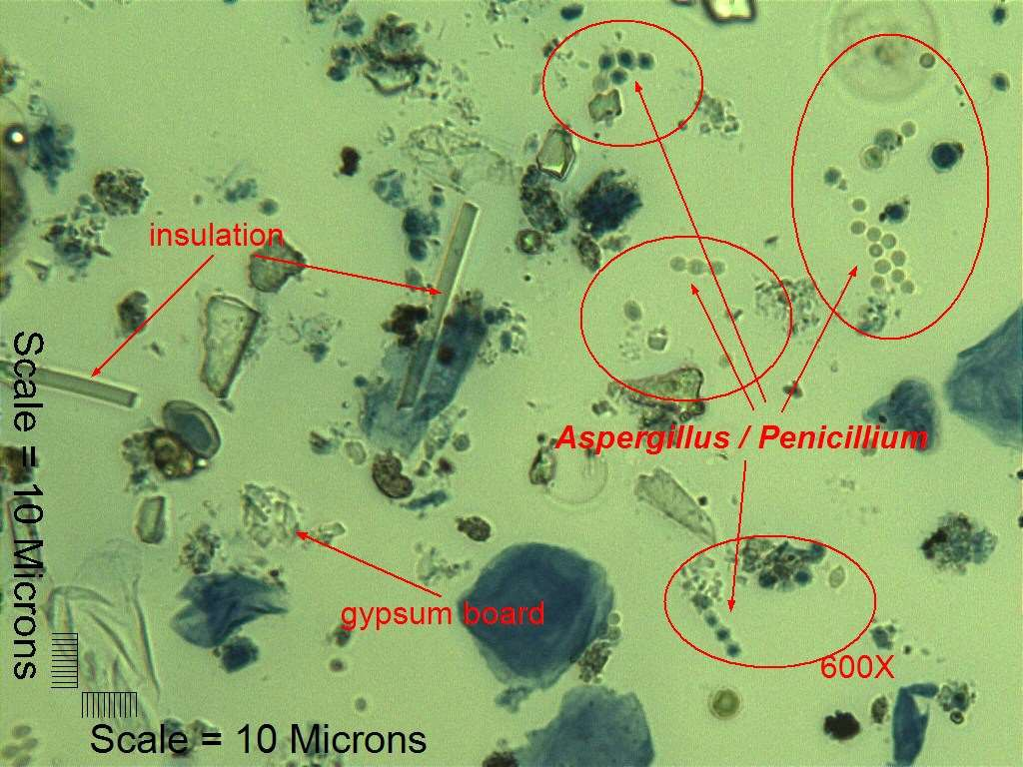
277

Slide 26
Outdoor Samples | Avg Count | Frequency Found | % Spores Identified | % of 5,870 Slides
Basidiospores | 18,801 | 5,737 | 76.19% | 97.7
Aspergillus / Penicillium | 1,361 | 5,429 | 5.22% | 92.5
Cladosporium | 2,654 | 5,160 | 9.67% | 87.9
Ascospores | 1,961 | 5,086 | 7.04% | 86.6
 |  |  | 98.13%
278

Slide 27
Indoor Samples | Avg Count | Frequency Found | % of Spores Found | % of 13700 Slides
Aspergillus / Penicillium | 23,587 | 12,585 | 81.72% | 91.86
Basidiospores | 3,687 | 12,474 | 12.66% | 91.05
Cladosporium | 801 | 9,227 | 2.03% | 67.35
Ascospores | 367 | 7,754 | 0.78% | 56.60
 |  |  | 97.20%
279

Slide 28
Quantity of Aspergillus/Penicillium Spores in the
Indoor Air of Houses
> 50 K
10 K - 50 K
10 %
7%
2 K - 10 K
10 %
< 500
49%
500 - 2 K
24%
280

Slide 29
Number out of 72 Spore types found in carpet dust associated with Health Concerns
Allergies: 25
Respiratory issues: 27
Headaches: 20
All Health Issues: 62 of 72

Slide 30
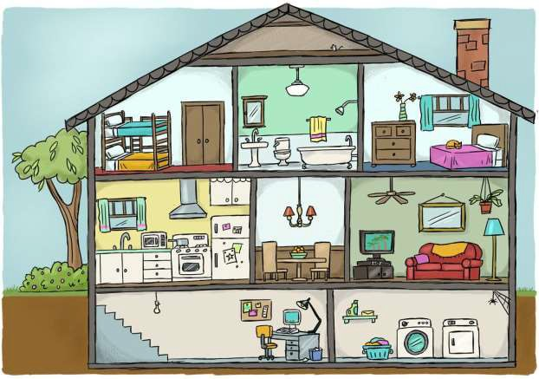
The missing Piece of the puzzle
282

Slide 31
Reducing Indoor Mold & Particulate
Filters
Housekeeping Dehumidifiers
(Airborne Triggers) (Surface Triggers)
(Humidity) Mold
Dust Mites Cockroaches Rodents Humidity Bacteria/Virus
Mold Spores Respirable particulate
Dust Mite
Cockroach
Rodents
Mold in Carpets Dust Mites Cockroaches Rodents
Pest Control
House Dust
Make Up Air: Chemical and Gases Dilution
283

Slide 32
Who is telling the People?
Drug Companies sell Pharmaceuticals
Allergists treat allergies
Environmentalists focus on outdoor air
Pharmacists dispense drugs
Pulmonologists repair the lungs
Emergency room doctors stabilize the patient
Landlords minimize expenses
Health care educators focus on treatment
Insurance Companies pay for healthcare
None are responsible for home improvement
284

Slide 33
Remediation
Stop the water intrusion
Prevent the spread of mold spores.
Remove materials that cannot be cleaned.
Kill the mold with a fungicide.
Remove spores by wiping or vacuuming,
exhausting the vacuum outside.
Seal the remaining spores.
Protect yourself
Use safe chemicals and encapsulants.
285

Slide 34
Integrated Care Model
Pulmonologist
Case Worker/ Hospital/ Primary Care/ Parent
Allergist
Asthma, COPD, and other diseases.
Legislation and Legal Issues
Pharmacist
Indoor Environmentalist
286

